Slide 1
Second Part and Third Part of Final Accounts- Profit & Loss Account and Balance Sheet

Slide 2
P/L A/C- Concept
The account that shows annual net profit or net loss of a business is called Profit and Loss Account. It is prepared to determine the net profit or net loss of a trader. P&L account is a component of final accounts.

Slide 3
Difference between Gross Profit and Net Profit
Gross profit is your business’s revenue minus the cost of goods sold. Your cost of goods sold (COGS) is how much money you spend directly making your products. But, your business’s other expenses are not included in your COGS. Gross profit is your company’s profit before subtracting expenses.

Slide 4
Differences Continued…
Net profit is your business’s revenue after subtracting all operating, interest, and tax expenses, in addition to deducting your COGS. To calculate net profit, you must know your company’s gross profit. Your business’s net profit is known as a net loss if the number is negative.

Slide 5
Example
Let’s say your business brought in $12,000 in sales during one accounting period and had a total cost of goods sold of $4,000. Subtract $4,000 from $12,000 to get your gross profit of $8,000

Slide 6
Example continued…
Using the above example for gross profits, let’s say your business has a gross profit of $8,000 during an accounting period. You also have expenses of $1,000 for rent, $250 for utilities, $2,000 for employee wages, $300 for supplies, $500 in depreciation, $1,000 in taxes, and $250 in interest.

Slide 7
Why knowing the difference between gross and net profit matters
Investors and lenders want to know about the financial health of your business, and showing them your gross profits just won’t cut it. You must know your company’s net profits when seeking outside lenders. That way, investors and lenders can determine how much money you have after paying all your expenses.
To create your income statement, you need to be able to calculate both gross and net profit. Confusing the two will only lead to muddled and inaccurate documents.

Slide 8
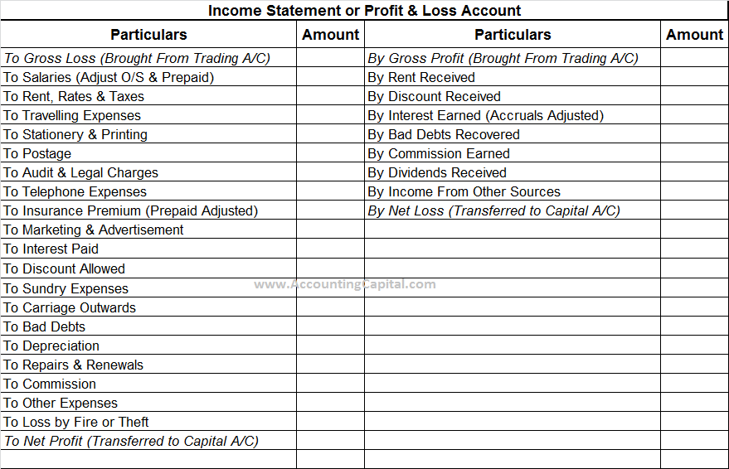
Format of Profit and Loss Account

Slide 9
How to know if an expense will go to Trading Account or P/L Account?
Trading Account ALWAYS lists Direct expenses.
P/L Account will list all the indirect expenses.
Thus, Trading account shows the Gross Profit.
P/L Account shows the Net Profit.

Slide 10
Expenses to consider…
Administrative
Selling and Distribution
Financial Expenses
Legal Expenses

Slide 11
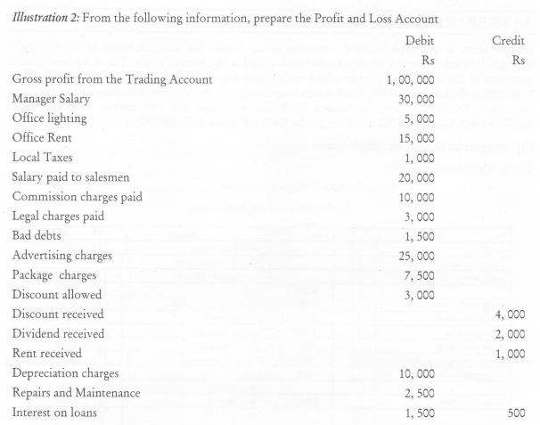
Illustration

Slide 12
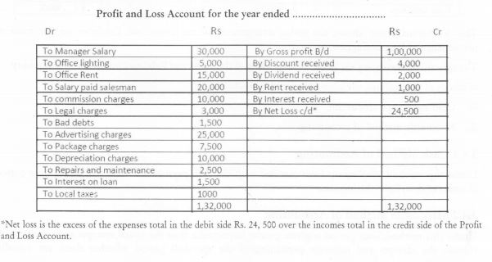
Solution

Slide 13
Entering the third stage: Balance Sheet
A balance sheet is a financial statement that reports a company's assets, liabilities and shareholders' equity at a specific point in time.

Slide 14
Why Balance sheet is prepared?
It is a snapshot at a single point in time of the company's accounts – covering its assets, liabilities and shareholders' equity. The purpose of a balance sheet is to give interested parties an idea of the company's financial position, in addition to displaying what the company owns and owes

Slide 15
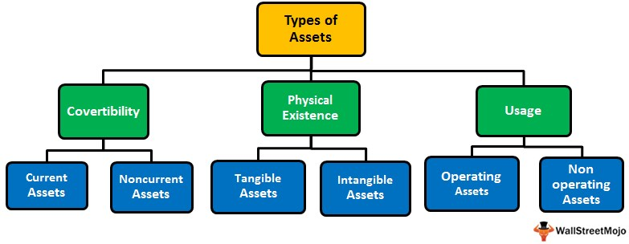
Classification of Asset

Slide 16
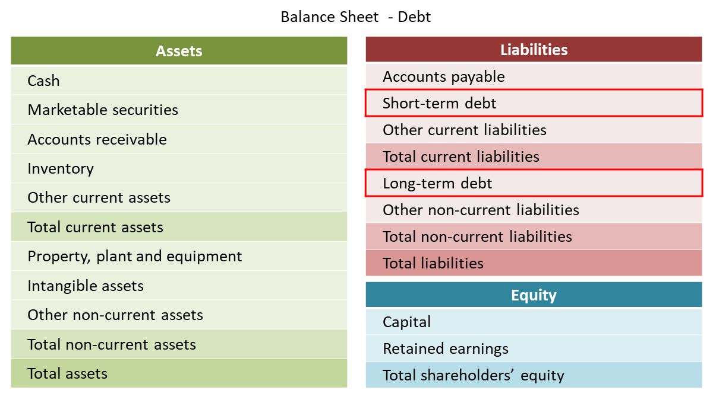
Classification of liabilities

Slide 17
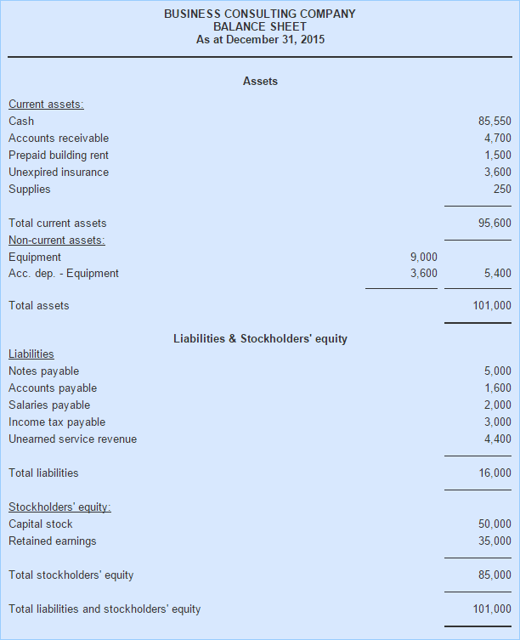
Format of Balance Sheet

Slide 18
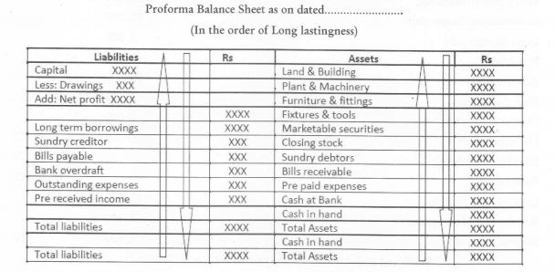
Format 2

Slide 19
Class End Exercise
Distinguish between Trading Account and Profit and Loss Account (5 points)
What are the roles of a Balance Sheet? How is it different from Trial Balance? (10 points)

Slide 20
Thank You

